Slide 1
Data Structures and Algorithms

Slide 2

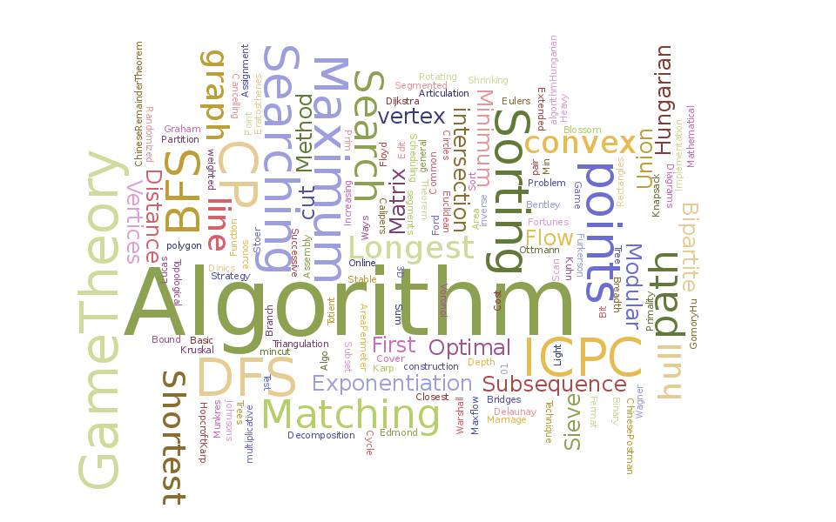
Lesson Objectives
Data Structures
Collections
Analyzing an Algorithm
Non-primitive data structures
Arrays
Linked Lists
Binary Tree
General Tree
Heaps
Queues
Stacks
Sorting Algorithms
Searching Algorithms

Slide 3
Data Structures
Section 1

Slide 4
Data Structures
"Once you succeed in writing the programs for complicated algorithms, they usually run extremely fast. The computer doesn't need to understand the algorithm, it’s task is only to run the programs.“
There are a number of facets to good programs, they must
run correctly
run efficiently
be easy to read and understand
be easy to debug and
be easy to modify.

Slide 5
Data Structures (Cont.)
What is Data Structure ?
A scheme for organizing related pieces of information
A way in which sets of data are organized in a particular system
An organised aggregate of data items
A computer interpretable format used for storing, accessing, transferring and archiving data
The way data is organised to ensure efficient processing: this may be in lists, arrays, stacks, queues or trees
Data structure is a specialized format for organizing and storing data so that it can be be accessed and worked with in appropriate ways to make an a program efficient

Slide 6
Data Structures (Cont.)
Data structures can be classified in to
Primitive data structures
Non primitive data structure.
Primitive data structure:
These are data structures that can be manipulated directly by machine instructions.
In C language, the different primitive data structures are int, float, char, double.
Non primitive data structures:
These are data structures that can not be manipulated directly by machine instructions. Arrays, linked lists, files etc., are some of non-primitive data structures and are classified into linear data structures and non-linear data structures.

Slide 7
Data Structures (Cont.)
Data Structure = Organised Data + Allowed Operations
There are two design aspects to every data structure:
the interface part
The publicly accessible functions of the type. Functions like creation and destruction of the object, inserting and removing elements (if it is a container), assigning values etc.
The implementation part :
Internal implementation should be independent of the interface. Therefore, the details of the implementation aspect should be hidden out from the users.

Slide 8
Collections
Programs often deal with collections of items.
These collections may be organised in many ways and use many different program structures to represent them, yet, from an abstract point of view, there will be a few common operations on any collection.
create | Create a new collection
add | Add an item to a collection
delete | Delete an item from a collection
find | Find an item matching some criterion in the collection
destroy | Destroy the collection

Slide 9
Analyzing an Algorithm
Section 2

Slide 10
Analyzing an Algorithm
Simple statement sequence
s₁; s₂; …. ; s_{k}
Complexity is O(1) as long as k is constant
Simple loops
for(i=0;i<n;i++) { s; } where s is O(1)
Complexity is n O(1) or O(n)
Loop index doesn’t vary linearly
h = 1; while ( h <= n ) { s; h = 2 * h;}
Complexity O(log n)
Nested loops (loop index depends on outer loop index)
for(i=0;i<n;i++) f
for(j=0;j<n;j++) { s; }
Complexity is n O(n) or O(n²)

Slide 11
Non-primitive data structures
Section 3

Slide 12
Arrays
An Array is the simplest form of implementing a collection
Each object in an array is called an array element
Each element has the same data type (although they may have different values)
Individual elements are accessed by index using a consecutive range of integers
One Dimensional Array or vector
int A[10];
for ( i = 0; i < 10; i++)
A[i] = i +1;
A[0] 1 | A[1] 2 | A[2] 3 | A[3] 4 |  |  | A[n-2] N-1 | A[n-1] N

Slide 13
Arrays (Cont.)
Multi-dimensional Array
A multi-dimensional array of dimension n (i.e., an n-dimensional array or simply n-D array) is a collection of items which is accessed via n subscript expressions. For example, in a language that supports it, the (i,j) th element of the two-dimensional array x is accessed by writing x[i,j].
R
O
W
C o l u m n
0
1
2
3
4
5
6
7
8
9
10
j
n
0
1
2
:
:
:
:
:
:
:
:
:
:
:
:
:
:
:
i
x
m

Slide 14
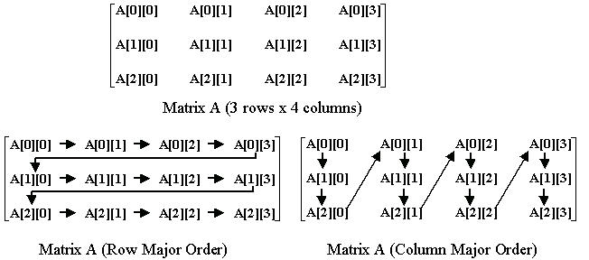
Arrays (Cont.)

Slide 15
Array : Limitations
Simple and Fast but must specify size during construction
If you want to insert/ remove an element to/ from a fixed position in the list, then you must move elements already in the list to make room for the subsequent elements in the list.
Thus, on an average, you probably copy half the elements.
In the worst case, inserting into position 1 requires to move all the elements.
Copying elements can result in longer running times for a program if insert/ remove operations are frequent, especially when you consider the cost of copying is huge (like when we copy strings)
An array cannot be extended dynamically, one have to allocate a new array of the appropriate size and copy the old array to the new array

Slide 16
Linked Lists
The linked list is a very flexible dynamic data structure: items may be added to it or deleted from it at will
Dynamically allocate space for each element as needed
Include a pointer to the next item
the number of items that may be added to a list is limited only by the amount of memory available
Linked list can be perceived as connected (linked) nodes
Each node of the list contains
the data item
a pointer to the next node
The last node in the list contains a NULL pointer to
indicate that it is the end or tail of the list.
Data
Next
object

Slide 17
Collections
Collection structure has a pointer to the list head
Initially NULL
Add first item
Allocate space for node
Set its data pointer to object
Set Next to NULL
Set Head to point to new node
The variable (or handle) which represents the list is simply a pointer to the node at the head of the list.
Collection
node
Tail
Head
Data
Next
object

Slide 18
Linked Lists (Cont.)
Collection
Add a node
Allocate space for node
Set its data pointer to object
Set Next to current Head
Set Head to point to new node
Head
node
node
Data
Next
Data
Next
object2
object

Slide 19
Linked Lists - Add implementation
Implementation
struct t_node {
void *item; struct t_node *next; } node;
typedef struct t_node *Node;
struct collection {
Node head;
……
};
int AddToCollection( Collection c, void *item ) {
Node new = malloc( sizeof( struct t_node ) );
new->item = item;
new->next = c->head; c->head = new;
return TRUE;
}
Recursive type definition -
C allows it!
Error checking, asserts
omitted for clarity!

Slide 20
Linked Lists - Find implementation
Implementation
void *FindinCollection( Collection c, void *key ) {
Node n = c->head;
while ( n != NULL ) {
if ( KeyCmp( ItemKey( n->item ), key ) == 0 ) {
return n->item;
n = n->next;
}
return NULL;
}
Add time Constant - independent of n
Search time Worst case - n
A recursive implementation is also possible!

Slide 21
Linked Lists - Delete implementation
Implementation
void *DeleteFromCollection( Collection c, void *key ) {
Node n, prev;
n = prev = c->head;
while ( n != NULL ) {
if ( KeyCmp( ItemKey( n->item ), key ) == 0 ) {
prev->next = n->next;
return n;
}
prev = n; n = n->next;
}
return NULL;
}
head

Slide 22
Linked Lists - Variations
Simplest implementation
Add to head
Last-In-First-Out (LIFO) semantics
Modifications
First-In-First-Out (FIFO)
Keep a tail pointer
struct t_node {
void *item; struct t_node *next; } node;
typedef struct t_node *Node;
struct collection {
Node head, tail;
};
head
By ensuring that the tail of the list is always pointing to the head, we can build a circularly linked list
head is tail->next
LIFO or FIFO using ONE pointer
tail

Slide 23
Linked Lists - Doubly linked
Doubly linked lists
Can be scanned in both directions
Applications requiring both way search
Eg. Name search in telephone directory
struct t_node {
void *item; struct t_node *prev,
*next; } node;
typedef struct t_node *Node;
struct collection {
Node head, tail;
};
head
prev
prev
prev
tail

Slide 24
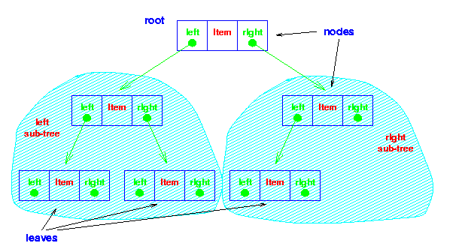
Binary Tree
The simplest form of Tree is a Binary Tree
Binary Tree Consists of
Node (called the ROOT node)
Left and Right sub-trees
Both sub-trees are binary trees
The nodes at the lowest levels of the tree (the ones with no sub-trees) are called leaves
Note the
recursive
definition!
In an ordered binary tree the keys of all the nodes in
the left sub-tree are less than that of the root
the keys of all the nodes in the right sub-tree are greater than that of the root,
the left and right sub-trees are themselves ordered binary trees.
Each sub-tree
is itself
a binary tree

Slide 25
Collections
If A is the root of a binary tree and B is the root of its left/right subtree then
A is the father of B
B is the left/right son of A
Two nodes are brothers if they are left and right sons of the same father
Node n1 is an ancestor of n2 (and n2 is descendant of n1) if n1 is either the father of n2 or the father of some ancestor of n2
Strictly Binary Tree: If every nonleaf node in a binary tree has non empty left and right subtrees
Level of a node: Root has level 0. Level of any node is one more than the level of its father
Depth: Maximum level of any leaf in the tree
A binary tree can contain at most 2^{l} nodes at level l
Total nodes for a binary tree with depth d = 2^{d+1} - 1
A
B
C
D
E
F
G

Slide 26
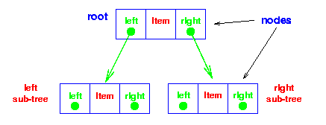
Binary Tree - Implementation
struct t_node {
void *item; struct t_node *left;
struct t_node *right; };
typedef struct t_node *Node;
struct t_collection { Node root;
……
};

Slide 27
Binary Tree - Implementation
Find
extern int KeyCmp( void *a, void *b );
/* Returns -1, 0, 1 for a < b, a == b, a > b */
void *FindInTree( Node t, void *key ) {
if ( t == (Node)0 ) return NULL;
switch( KeyCmp( key, ItemKey(t->item) ) ) {
case -1 : return FindInTree( t->left, key );
case 0: return t->item;
case +1 : return FindInTree( t->right, key );
}
}
void *FindInCollection( collection c, void *key ) {
return FindInTree( c->root, key );
}
Less,
search
left
Greater,
search right

Slide 28
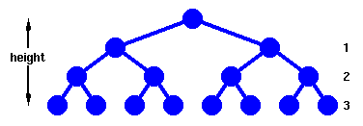
Binary Tree - Performance
Find
Complete Tree
Height, h
Nodes traversed in a path from the root to a leaf
Number of nodes, h
n = 1 + 2¹ + 2² + … + 2^{h} = 2^{h+1} - 1
h = floor( log₂ n )
Since we need at most h+1 comparisons, find in O(h+1) or O(log n)

Slide 29
Binary Tree - Traversing
Traverse: Pass through the tree, enumerating each node once
PreOrder (also known as depth-first order)
1. Visit the root
2. Traverse the left subtree in preorder
3.Traverse the right subtree in preorder
InOrder (also known as symmetric order)
1. Traverse the left subtree in inorder
2. Visit the root
3. Traverse te right subtree in inorder
PostOrder (also known as symmetric order)
1. Traverse the left subtree in postorder
2. Traverse the right subtree in postorder
3. Visit the root

Slide 30
Binary Tree - Applications
A binary tree is a useful data structure when two-way decisions must be made at each point in a process
Example: Finding duplicates in a list of numbers
A binary tree can be used for representing an expression containing operands (leaf) and operators (nonleaf node).
Traversal of the tree will result in infix, prefix or postfix forms of expression
Two binary trees are MIRROR SIMILAR if they are both empty or if they are nonempty, the left subtree of each is mirror similar to the right subtree

Slide 31
General Tree
A tree is a finite nonempty set of elements in which one element is called the ROOT and remaining element partitioned into m >=0 disjoint subsets, each of which is itself a tree
Different types of trees – binary tree, n-ary tree, red-black tree, AVL tree
A Hierarchical Tree

Slide 32
Heaps
Heaps are based on the notion of a complete tree
A binary tree is completely full if it is of height, h, and has 2h+1-1 nodes.
A binary tree of height, h, is complete iff
it is empty or
its left subtree is complete of height h-1 and its right subtree is completely full of height h-2 or
its left subtree is completely full of height h-1 and its right subtree is complete of height h-1.
A complete tree is filled from the left:
all the leaves are on
the same level or two adjacent ones and
all nodes at the lowest level are as far to the left as possible.
A binary tree has the heap property iff
it is empty or
the key in the root is larger than that in either child and both subtrees have the heap property.

Slide 33
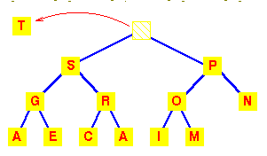
Heaps (Cont.)
A heap can be used as a priority queue:
the highest priority item is at the root and is trivially extracted. But if the root is deleted, we are left with two sub-trees and we must efficiently re-create a single tree with the heap property.
The value of the heap structure is that we can both extract the highest priority item and insert a new one in O(logn) time.
Example:
A deletion will remove the
T at the root

Slide 34
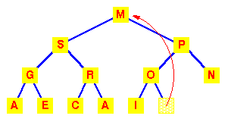
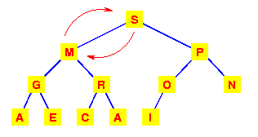
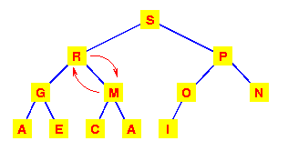
Heaps (Cont.)
To work out how we're going to maintain the heap property, use the fact that a complete tree is filled from the left. So that the position which must become empty is the one occupied by the M. Put it in the vacant root position.
This has violated the condition that the root must be greater than each of its children. So interchange the M with the larger of its children.
The left subtree has now lost the heap property. So again interchange the M with the larger of its children.
We need to make at most h interchanges of a root of a subtree with one of its children to fully restore the heap property.
O(h) or O(log n)

Slide 35
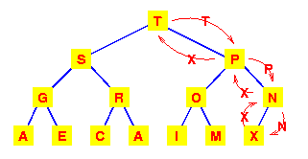
Heaps (Cont.)
Addition to a Heap
To add an item to a heap, we follow the reverse procedure.
Place it in the next leaf position and move it up.
Again, we require O(h) or O(logn) exchanges.

Slide 36
Data Structure Comparisons
Add
Delete
Find
Arrays
Simple, fast
Inflexible
O(1)
O(n) inc sort
O(n)
O(n)
O(logn)
binary search
Linked List
Simple
Flexible
O(1)
sort -> no adv
O(1) - any
O(n) - specific
O(n)
(no bin search)
Trees
Still Simple
Flexible
O(log n)
O(log n)
O(log n)

Slide 37
Queues
Queues are dynamic collections which have some concept of order
FIFO queue
A queue in which the first item added is always the first one out.
LIFO queue
A queue in which the item most recently added is always the first one out.
Priority queue
A queue in which the items are sorted so that the highest priority item is always the next one to be extracted.
Queues can be implemented by Linked Lists

Slide 38
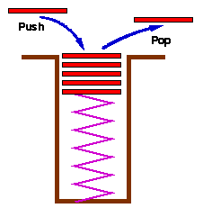
Stacks
Stacks are a special form of collection with LIFO semantics
Two methods
int push( Stack s, void *item );
add item to the top of the stack
void *pop( Stack s );
remove most recently pushed item from the top of the stack
Like a plate stacker
Other methods
int IsEmpty( Stack s );
Determines whether the stack has anything in it
void *Top( Stack s );
Return the item at the top without deleting it
* Stacks are implemented by Arrays or Linked List

Slide 39
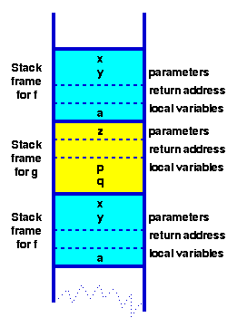
Stacks (Cont.)
Stack very useful for Recursions
Key to call / return in functions & procedures
function f( int x, int y) { int a; if ( term_cond ) return …; a = ….; return g( a ); } function g( int z ) { int p, q; p = …. ; q = …. ; return f(p,q); }

Slide 40
Sorting Algorithms
Section 4

Slide 41
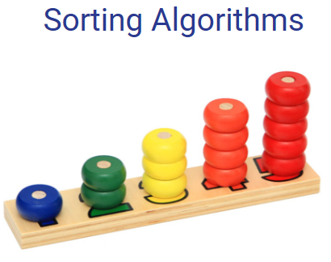
Sorting Algorithms
A file is said to be SORTED on the key if i < j implies that k[i] preceeds k[j] in some ordering of the keys
Different types of Sorting
Exchange Sorts
Bubble Sort
Quick Sort
Insertion Sorts
Selection Sorts
Heap Sort
Binary Tree Sort
Merge and Radix Sorts

Slide 42
Insertion Sort
First card is already sorted
With all the rest,
Scan back from the end until you find the first card larger than the new one O(n)
Move all the lower ones up one slot O(n)
insert it O(1)
For n cards Complexity O(n²)
¸
©
9
A
K
10
5
J
4
2
Q
9
¶

Slide 43
Bubble Sort
From the first element
Exchange pairs if they’re out of order
Repeat from the first to n-1
Stop when you have only one element to check
/* Bubble sort for integers */
#define SWAP(a,b) { int t; t=a; a=b; b=t; }
void bubble( int a[], int n ) {
int i, j;
for(i=0;i<n;i++) { /* n passes thru the array */
/* From start to the end of unsorted part */
for(j=1;j<(n-i);j++) {
/* If adjacent items out of order, swap */
if( a[j-1]>a[j] ) SWAP(a[j-1],a[j]);
}
}
}
Overall O(n2)
Outer loop n iterations
Inner loop
n-1, n-2, n-3, … , 1 iterations
O(1) statement

Slide 44
Selection Sort
Algorithm:
Pass through elements sequentially;
In the i^{th} pass, we select the element with the lowest value in A[i] through A[n], then swap the lowest value with A[i].
Time complexity: O(n²)
Example: Sort the list {25, 57, 48, 37, 12}

Slide 45
Quick Sort 1/2
Quick sort, also known as partition sort, sorts by employing a divide-and-conquer strategy.
Algorithm:
Pick an pivot element from the input;
Partition all other input elements such that elements less than the pivot come before the pivot and those greater than the pivot come after it (equal values can go either way);
Recursively sort the list of elements before the pivot and the list of elements after the pivot.
The recursion terminates when a list contains zero or one element.
Time complexity: O(nlogn) or O(n²)
Demo: http://pages.stern.nyu.edu/~panos/java/Quicksort/
Example: Sort the list {25, 57, 48, 37, 12}

Slide 46
Quick Sort 2/2
Example of Divide and Conquer algorithm
Two phases
Partition phase
Divides the work into half
Sort phase
Conquers the halves!
quicksort( void *a, int low, int high ) {
int pivot;
if ( high > low ) /* Termination condition! */ {
pivot = partition( a, low, high );
quicksort( a, low, pivot-1 );
quicksort( a, pivot+1, high );
}
}
< pivot
pivot
> pivot
< p’
p’
> p’
pivot
> pivot
p”
< p”
> p”
< pivot

Slide 47
Heap Sort
Heaps also provide a means of sorting:
construct a heap,
add each item to it (maintaining the heap property!),
when all items have been added, remove them one by one (restoring the heap property as each one is removed).
Addition and deletion are both O(logn) operations. We need to perform n additions and deletions, leading to an O(nlogn) algorithm
Generally slower
Notes:
Heapify phase:
Create a descending heap
Add element to a binary tree from top to bottom and from left to right
When adding a new element, if the element is out of order, perform “sift-up” operations (a sequence of swap with parent)
Example: {25, 57, 48, 37, 12}
Sorting phase
Work backwards from bottom to top and from right to left
Swap current element with root
For the new root, perform “sift-down” operations (swap with the larger son).
Time complexity:
Heapify: O(nlog₂n)
Sorting: O(nlog₂n)
Overall: O(nlog₂n) + O(nlog₂n) = O(nlog₂n)

Slide 48
Comparisons of Sorting
Insertion O(n²) Guaranteed
Bubble O(n²) Guaranteed
Heap O(n log n) Guaranteed
Quick O(n log n) Most of the time! O(n²)
Bin O(n) Keys in small range O(n+m)
Radix O(n) Bounded keys/duplicates O(nlog n)

Slide 49
Searching Algorithms
Fundamental operation
Finding an element in a (huge) set of other elements
Each element in the set has a key
Searching is the looking for an element with a given key
distinct elements may have (share) the same key
how to handle this situation?
first, last, any, listed, ...
May use a specialized data structure
Things to consider
the average time
the worst-case time and
the best possible time.

Slide 50
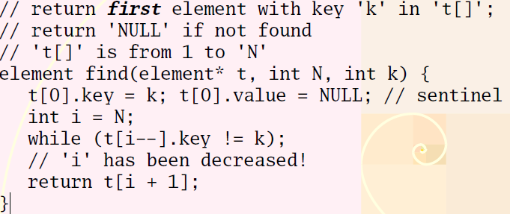
Sequential Search
Store elements in an array
Unordered

Slide 51
Sequential Search Analysis
Generic simple algorithm
Space complexity: O(1)
Time complexity
Time is proportional to n
We call this time complexity O(n)
Worst case: N + 1 comparisons
Best case: 1 comparison
Average case (successfull): (1+2+...+N)/N = (N+1)/2
Both arrays (unsorted) and linked lists

Slide 52
Sequential Search in a (sorted) Linked List 1/2
Keep the list sorted
Easy to implement with linked list (exercice: do it)!
// return first node with key 'k' in 'l';
// return 'NULL' if not found
// 'l' is sorted
node find(list l, int k) {
node z = list_end(l);
node_setKey(z, k); // sentinel
for (node n = list_start(l);
node_getKey(n) > k;
n = node_next(n));
if (node_getKey(n) != k) return NULL;
return n;
}

Slide 53
Sequential Search in a (sorted) Linked List 2/2
Space complexity: O(1)
Time complexity
Best case: 1 comparison
Average case (successfull): same as the sequential search in unordered list (array): (N+1)/2
Worst case (unsuccessfull):
consider the sentinel as part of the list
then a search is always “successfull” (finding the sentinel at least)
Hence: (N+2)/2

Slide 54
Sequential Search Improvements
Static caching
Use the relative access frequency of elements
store the most often accessed elements at the first places
Dynamic caching
For each access, move the element to the first position
Needs a linked list data structure to be efficient
Very difficult to analyze the complexity in theory: very efficient in practice

Slide 55
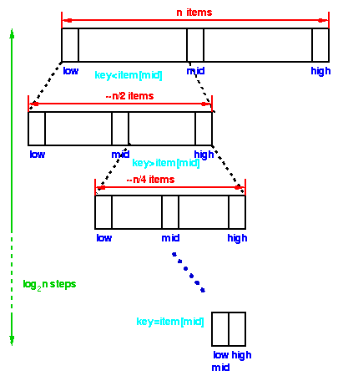
Binary Search
Sorted array on a key
first compare the key with the item in the middle position of the array
If there's a match, we can return immediately.
If the key is less than the middle key, then the item sought must lie in the lower half of the array
if it's greater then the item sought must lie in the upper half of the array
Repeat the procedure on the lower (or upper) half of the array - RECURSIVE
Time complexity O(log n)

Slide 56
Binary Search Implementation
static void *bin_search( collection c, int low, int high, void *key ) {
int mid;
if (low > high) return NULL; /* Termination check */
mid = (high+low)/2;
switch (memcmp(ItemKey(c->items[mid]),key,c->size)) {
case 0: return c->items[mid]; /* Match, return item found */
case -1: return bin_search( c, low, mid-1, key); /* search lower half */
case 1: return bin_search( c, mid+1, high, key ); /* search upper half */
default : return NULL;
}
}
void *FindInCollection( collection c, void *key ) {
/* Find an item in a collection
Pre-condition:
c is a collection created by ConsCollection
c is sorted in ascending order of the key
key != NULL
Post-condition: returns an item identified by key if one exists, otherwise returns NULL */
int low, high;
low = 0; high = c->item_cnt-1;
return bin_search( c, low, high, key );
}

Slide 57
Binary Search vs Sequential Search
Logs
Base 2 is by far
the most common
in this course.
Assume base 2
unless otherwise
noted!
Find method
Sequential search
Worst case time: c₁ n
Binary search
Worst case time: c₂ log₂n
Small
problems -
we’re not
interested!
n
Large
problems -
we’re
interested
in this gap!
log₂n
Binary search
More complex
Higher constant factor

Slide 58

Thank you
Q&A

